Slide 1

SMART 4.0 ONLINE PITCH COMPETITION
TOPIC- FOOD WASTE
TEAM 26
EWAN ATKINSON
VIDHI PATIDAR
XINZHI LIU
PRANAVV HARAN

Slide 2

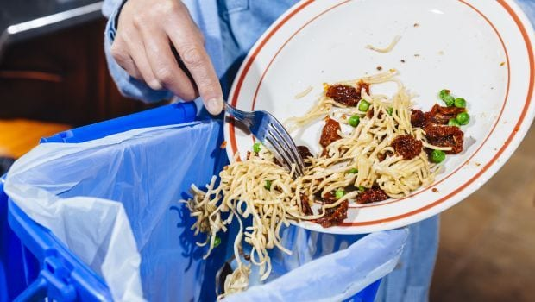
PROBLEM
01
Food left in hostel mess when students skip meals
02
Lack of transparent mess management system
03
Improper disposal of leftover food
04
Spoiled food in storage containers

Slide 3





SOLUTION
SMART Bin
SMART Storage
Introducing emerging technology in the developing world to tackle food waste management and facilitate service to enhance current processes in dining halls. This service integrates seamlessly into current processes, provides customers with business intelligence tools, and contributes to a circular bioeconomy.
Designs adept with the current fashion trends
AI Label on food storage containers
Mobile App
Rebate
App where students can browse through all mess management system
Get rebate if informing beforehand when skipping a meal

Slide 4
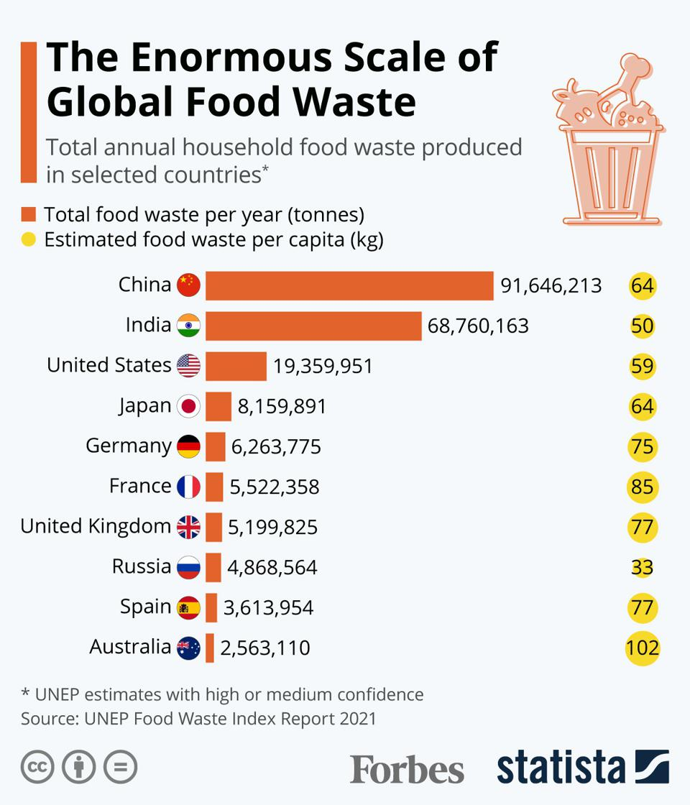
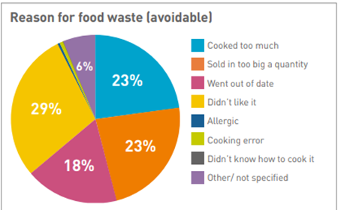
MARKET VALIDATION

Slide 5

MARKET SIZE
Wasted globally with 53% of food waste coming from Asia
573M
TAM
people buying products through SOCIAL MEDIA
SAM
people buying products through INFLUENCERS
212M
S0M
Target 1% share of Service available market
611 M
0%

Slide 6

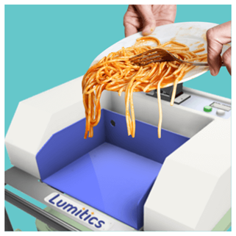
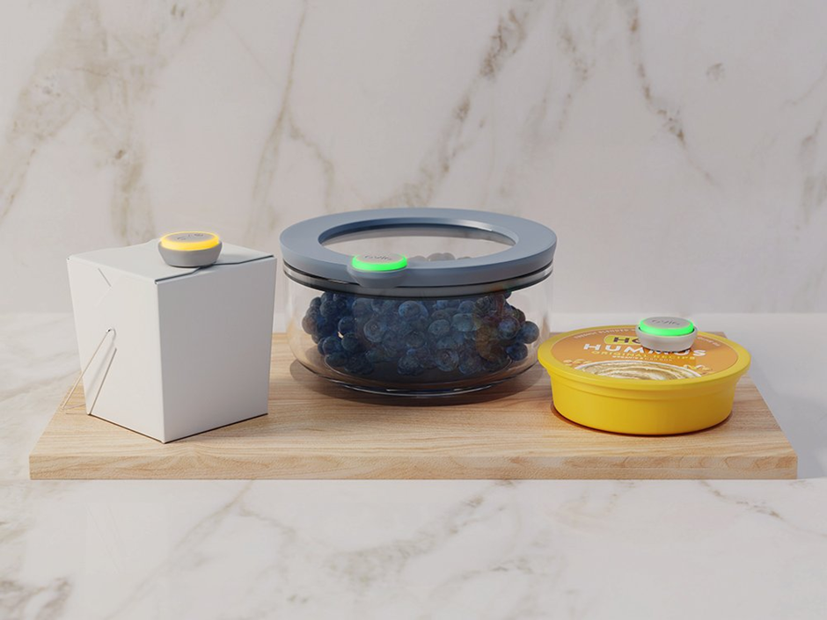
PRODUCT
…: Lumitic SMART bin | …: Winnow Solutions SMART bin
ATUP SMART bin
ATUP SMART food storage containers

Slide 7

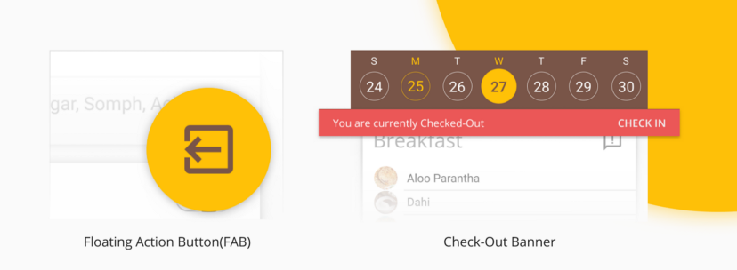
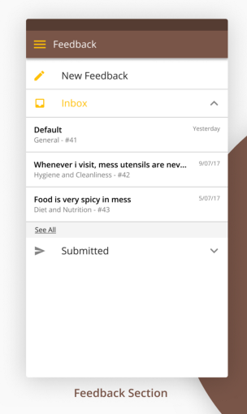
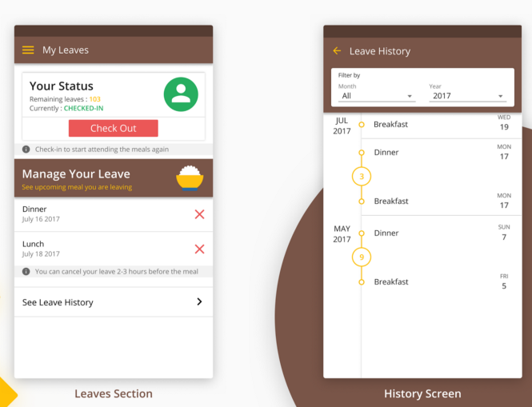


PRODUCT

Slide 8

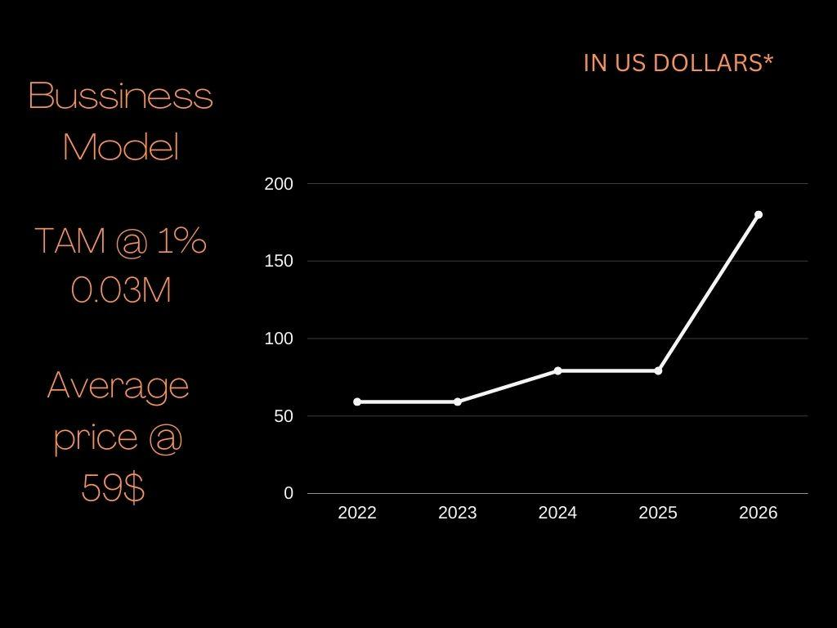
BUSINESS MODEL
* in Lakh Rupees
250
200
150
Equal profit sharing with influencers
100
50
₹30Cr
₹1000
0
-50
2021
2022
2023
2024
2025
Target .1% SAM for initial years
Avg selling price per merchandise

Slide 9


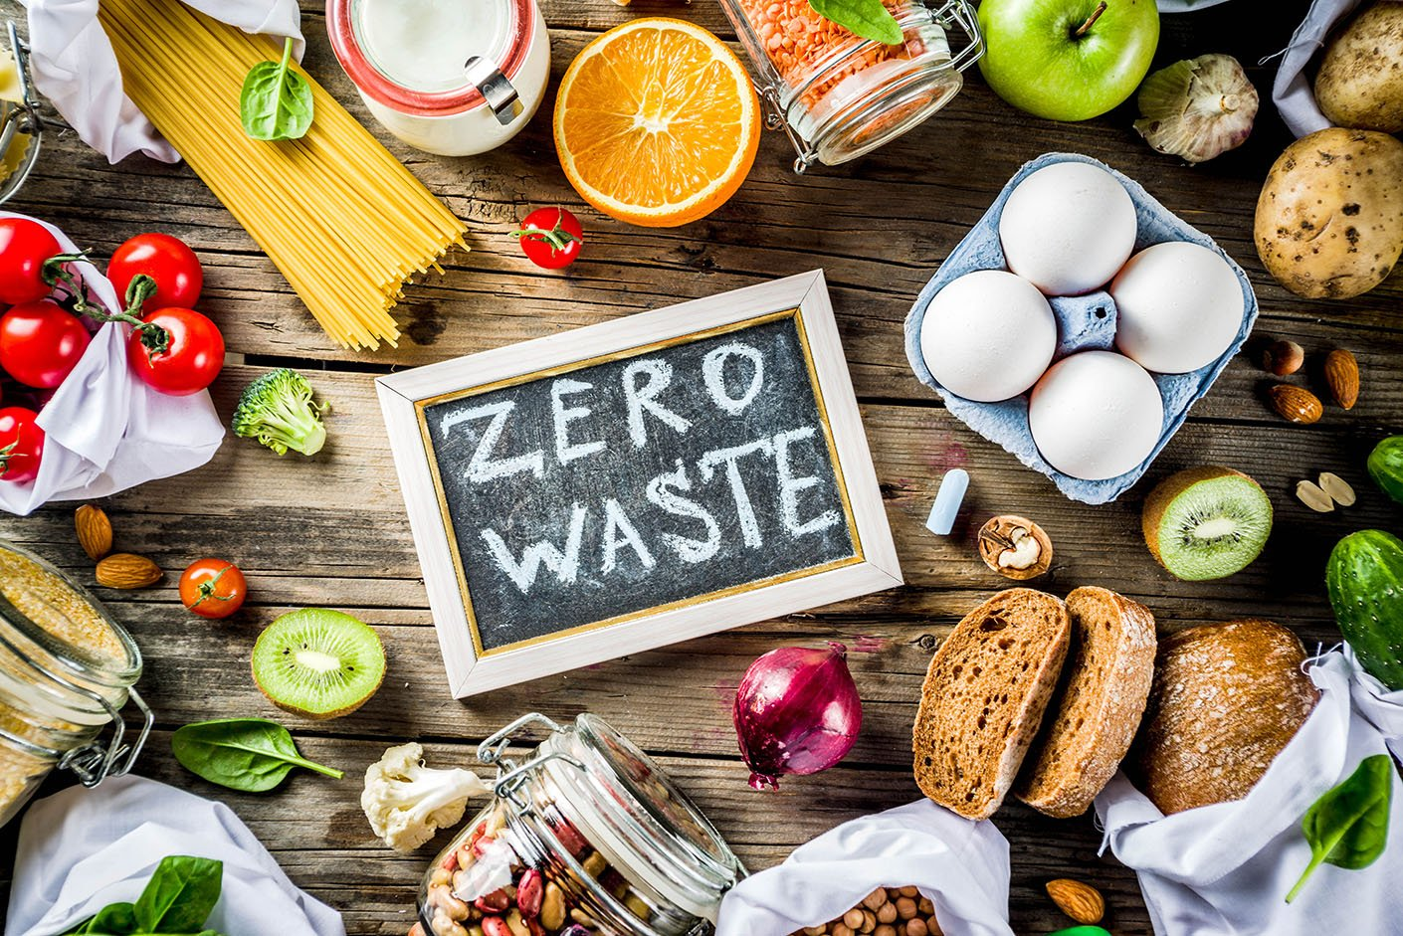
MARKET ADOPTION
Report from Grand View research, global food waste management accounted for USD 39,547 Million in 2021 and is estimated to achieve a market size of USD 64,025 Million by 2030 growing at a CAGR of 5.7% from 2022 to 2030 ( GVR,2021). Meanwhile, wasted globally with 53% of food waste coming from Asia, which means more than half of food management's market share is in Asia
Source: sellmerch.org

Slide 10





COMPETITIVE
ADVANTAGE
We help influencers grow their brand
Commercialized
Digitalized
Large Customer Base
. Provide the commercial mess management services
Visualized data and intelligent system
Wide customer base

Slide 11







COMPETITION
Cost of services
The reduction of food wastage

Slide 12
FINANCIALS
We are looking for startup cash to reach 3 Lakh Fans
65K$
3L
3.9L$
Seed Round
Transactions
Revenue over 5 Yrs
Break even point between 4-5 Years

Slide 13

Activities | Cost
For Developing website & APP | 15k
Employee Salaries | 15k
General Adminstrative Cost | 5k
Marketing & Promotion for 5 years | 20k
Research & Development | 5K
Miscellaneous | 5K
Total | 65,000$ In US $
ALL

Slide 14

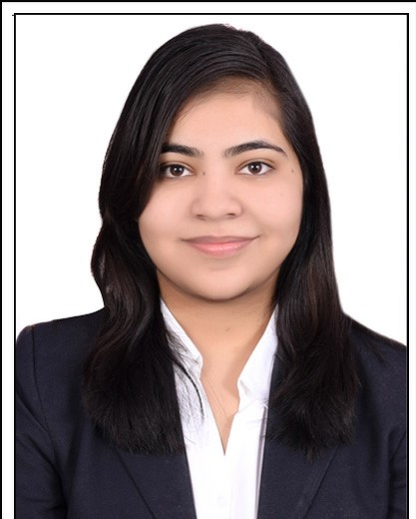
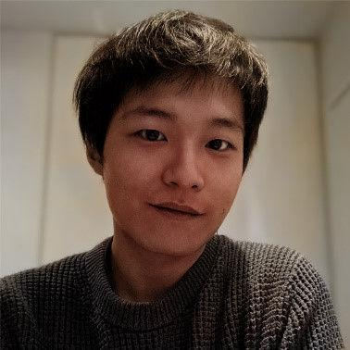

OUR TEAM
Ewan atKINSon
Vidhi patidar
XinZhi LIU
PRANAVV HARAN
CEO
CTO
CMO
CFO

Slide 15
THANK YOU

